Slide 1

Natasha Alexeeva, CEO
Work Less. Accomplish More.
Notes:
1

Slide 2
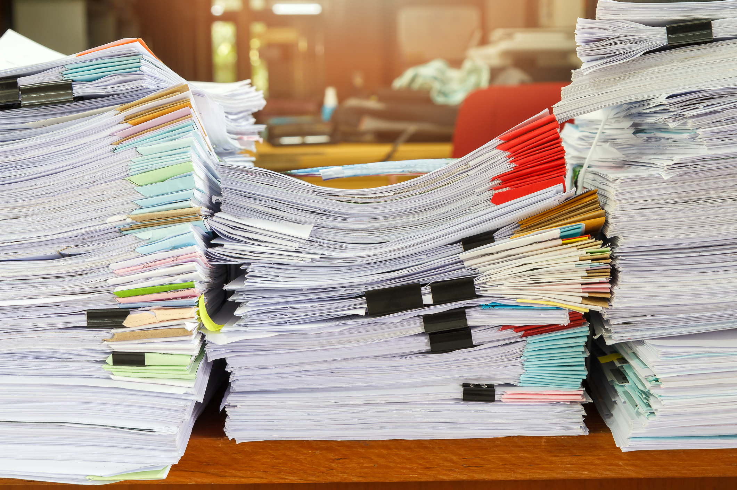

Slide 3


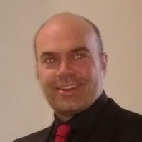
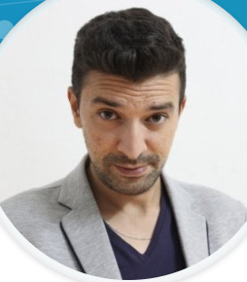
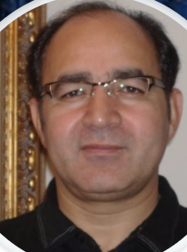
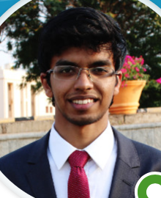
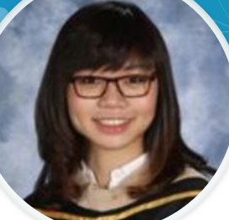
Natasha Alexeeva, CEO
  15 years of experience in applied deep learning
  Led teams at DARPA, Nielsen, VISA and Amazon
  Started and ran GoGoHealth, digital health startup
  Stanford MBA
Charles Rentmeesters, CTO
  25 years of industry experience
  Google Brain competition winner
  Developed scientific software in use in Antarctica
Team
  14 employees made up primarily of data scientists and software engineers

Slide 4
Our Journey

Slide 5
We digitize complex text in insurance paperwork, including handwritten notes and marks.

Slide 6
Use Cases

Slide 7
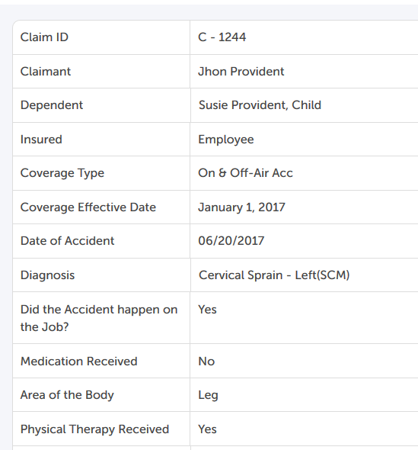
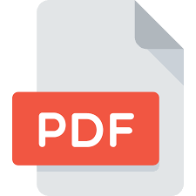

Use Case: Any Paperwork
Digitize and automate your intake process

Slide 8
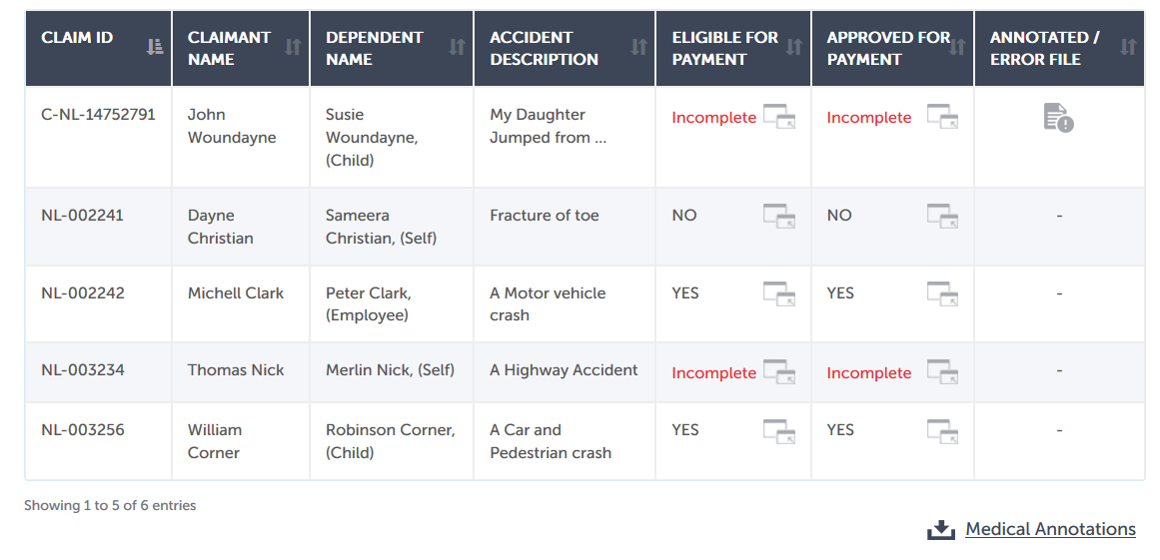
Use Case: Group Life Benefit
Integrate Friendly into your workflow to accept claims, perform automated intake,
and spot documents that are missing required for adjudication information

Slide 9
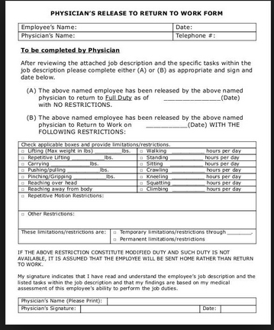
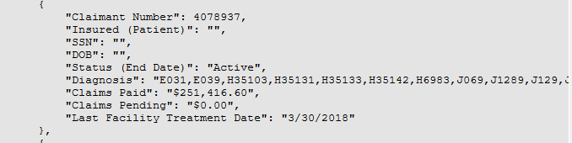
Use Case: Stop Loss
Use Friendly to process Attending Physician Statements to identify high cost claims

Slide 10

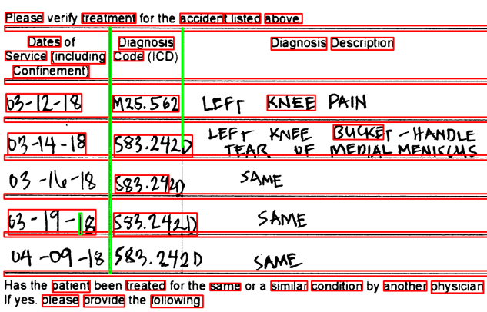
Use Case: Digitize Handwritting
Convert handwriting to structured digital format.
Date Employed (Date of Hire):
9/8/1981
Effective Date of Coverage for Employee: 11/1/2015
Complex structure identification, ICD code extraction, dates extraction, diagnosis description mapping.

Slide 11
www.friendlycares.com
natasha@friendlycares.com

